Slide 1
Translanguaging with Multilingual Learners
Naomi Wilks-Smith
Notes:
My presentation today is about translanguaging with multilingual learners. I’ll start with describing the context of multilingualism in Melbourne Australia, and will then provide some further details about what this looks like in one primary school in Melbourne (that I work in regularly with my university pre-service teachers). I will then go on to discuss what translanguaging is and some translanguaging pedagogies for teaching and learning, and share some examples of practice. We’ll end with time for questions and discussion.

Slide 2
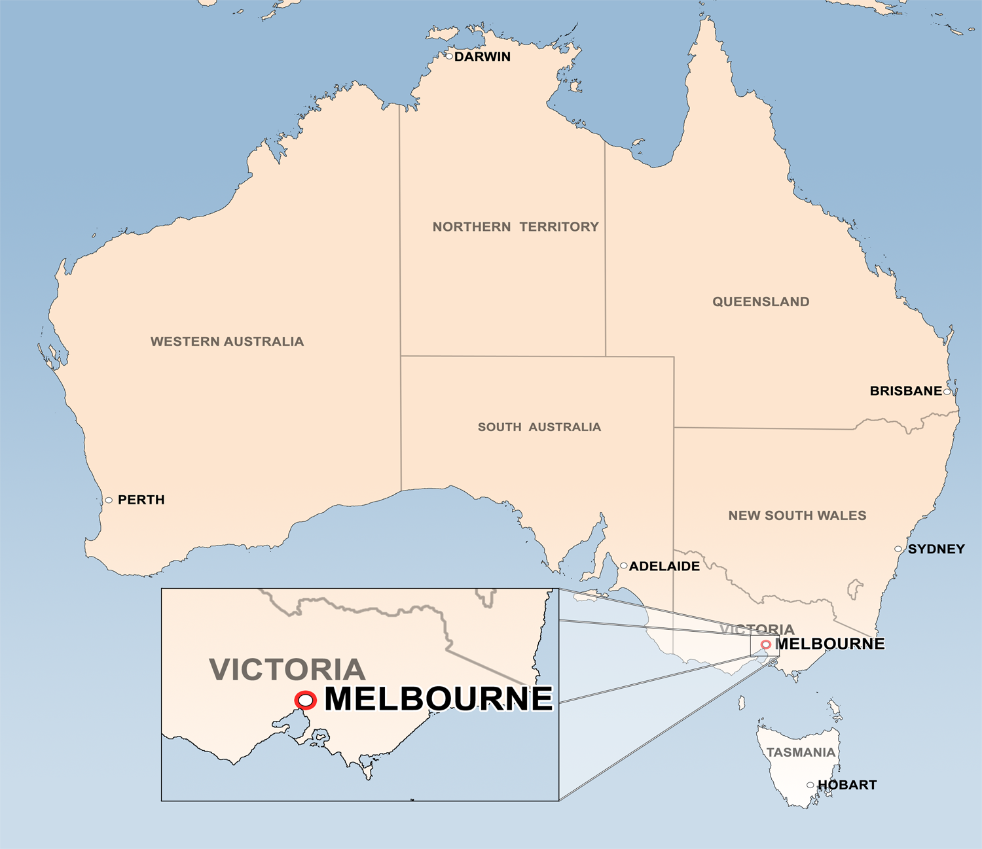
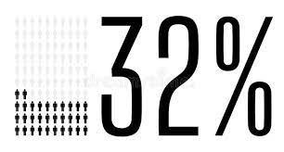

263 languages
Notes:
I’m from the city of Melbourne in the state of Victoria in Australia, and one of the most striking features of our population is the wide range of languages spoken in homes and communities. The latest census data revealed that there are 263 different languages and dialects spoken across Australia.
In the state of Victoria, 32% percent of students are from language backgrounds other than English. This percent is higher in more urban areas such as the city of Melbourne where I live, and is less in more rural regions.
So for teachers in Melbourne our classrooms are made up of students that are linguistically and culturally diverse and so this influences (or should influence) our teaching pedagogy.

Slide 3

A primary school example
324 students
More than 50% LBOTE
85 students in their first 5 years of English learning
Somali
Mandarin
Hakha-Chin
Tongan
Oromo
Korean
Notes:
An example from one local school that I work in regularly with university pre-service teachers has a total of 324 students enrolled at the school and over half of these students have LBOTE. 85 students of these students are within their first 5 years of English learning so receive support from an EAL program. Part of that support includes the RMIT university English as an additional language (or EAL) program that I run with my pre-service teachers. The PSTs are paired with an EAL buddy to work one-on-one with one afternoon a week throughout each university semester. You can see on the slide the wide range of languages that are represented at the school. Most students we work with have Somali or Chinese Mandarin backgrounds, there are also students from Myanmar, Burma, India, & Bangladesh who speak Hakha-Chin, there is a family who speaks Tongan, families from Ethiopia, & Kenya that speak Oromo, and two families with Korean. The range of languages do change over the years depending on immigration into the area at the time.
The examples of translanguaging that I am sharing with you today relates to the program at this school, and although it was interrupted by COVID in 2020, planning for translanguaging was stimulated by my own and pre-service teachers’ experiences in this context.

Slide 4




Bi-/multilingual learners
Use languages for various purposes & audiences
Languages are tools in learners’ communicative toolkits (Faulstich, 2015)
Languages are part of an interconnected system
Languages are often ‘left at the school gate’ (Wilks-Smith, 2017)
Languages are part of learners’ ‘virtual school bags’ (Thomson, 2002; Thomson & Hall, 2008)
Notes:
Let’s take a moment to think about these bilingual and multilingual learners.
They routinely use their languages for a variety of purposes in their daily lives. And they make choices about which language to use with each person in each context. So in this way, their languages are described by Faulstich as “… tools in their communicative toolkits, which they use flexibly according to need and circumstance”. And these languages are not separate entities but are part of an interconnected system.
In Melbourne, despite the incredible linguistic diversity amongst students, schools are overwhelmingly monolingual English-centered spaces where “… languages are often ‘left at the school gate’ and are not recognised or celebrated at school” (Wilks-Smith, 2017) and English is the medium for teaching and assessing students. This current practice ignores the valuable skills of multilingual students.
If we believe that bilingual and multilingual learners’ languages are “… tools in their communicative toolkits…” then Faulstich (2015) explains that prohibiting the use of languages would be “…like telling a carpenter to build a house using only half of the tools in his or her toolbox” (Faulstich, 2015, p. 105). So, in a school context, if we exclude languages other than the school language at school, we are asking students to leave their languages, including part of their knowledge tied to the language at the school gate. And this also implicitly tells the students that their languages aren’t relevant or important at school.
Related to this, in the field of education broadly, academics and teachers often talk about students’ ‘virtual school bags’. Thomson (Thomson, 2002), refers to this as the knowledge, understandings and experiences that students bring with them to school, and the importance of these virtual school bags to leverage in-school learning. But Thomson and Hall (2008) explain that often on a practical level, “… school only draws on the contents of some children’s school bags, those whose resources match those required in the game of education” (Thomson & Hall, 2008, p.4). Languages are key elements of students’ school bags that tends to privilege some and disadvantages others. Monolingual English-speaking students enter Australian classrooms where their English literacy knowledge is readily understood, whilst bilingual and multilingual learners discard much of their school bags that do not seem to ‘fit’ the classroom environment. Schooling therefore commences from these inequitable starting points. We know that bilingual and multilingual students have linguistic competencies in their languages, have had experiences, and have developed conceptual understandings and cultural knowledge across their languages. However, often teachers know little of students’ prior experiences, knowledge and understandings that are not in English or about their skills in additional languages, so they are not validated or utilised in their learning and even more rarely, considered when assessing students.

Slide 5
Translanguaging
Brings languages into classrooms
Uses learners’ full “linguistic repertoire” (Garcia, 2009)
Promotes student use of languages & connects them with their learning
Values, embraces and integrates linguistic skills, experiences and cultural knowledge into classroom practice
Resources for further learning
Cognitive resources
Notes:
So translanguaging offers a practical way to bring languages that are often invisible at school into classrooms.
It is a pedagogical approach that reflects the out-of-school language practices of multilinguals and considers their full “linguistic repertoire” whilst bringing their language practices into the classroom (García, 2009).
It utilises pedagogical ways that promotes students’ use of their full set of linguistic resources and connects these with their learning.
By doing this, translanguaging values, embraces & integrates multilinguals’ linguistic skills, experiences and cultural knowledge into classroom practice.
They become resources for further learning and are also valuable cognitive resources for students to use.
So in a practical sense, it means using a diversity of languages in classrooms. The purpose is not only to promote and show value of learners’ languages, but to leverage classroom learning through use of the languages. Students can demonstrate their knowledge best across languages, can use their languages as resources for further learning (such as for reading and research), and they are important cognitive resources that activate knowledge, understandings and experiences across languages. I’ll expand further with some examples of practice shortly.

Slide 6
‘Stance’, ‘Design’ and ‘Shift’
Stance – multilingualism is a resource to think and learn in.
Design – design teaching-learning that integrates students’ linguistic repertoires
  Constructing collaborative/ cooperative structures,
  Collecting varied multilingual and multimodal instructional resources, and
  Using translanguaging pedagogical practices. (García & Kleyn, 2016, p.21).
Shift – teaching needs to shift to respond to learners’ languages, needs and practices.
(García, Johnson and Seltzer, 2017)
Notes:
Critical to adopting a translanguaging pedagogy are García, Johnson and Seltzer’s (2017) notions of ‘stance’, ‘design’ and ‘shift’. A teacher’s stance is where they view students’ multilingualism as central to their identities. This is an important foundational philosophy of translanguaging. Teachers must believe that multilingualism is a resource for learners to think and learn in, should allow learners to determine how they use their linguistic repertoires, and believe that translanguaging enables learners to use languages in a natural way for them.
Then teachers need to design instruction that integrates students’ linguistic repertoires. “Designing instruction based on translanguaging theory requires three elements: 1) constructing collaborative/cooperative structures, 2) collecting varied multilingual and multimodal instructional resources, and 3) using translanguaging pedagogical practices” (García & Kleyn, 2016, p.21). Translanguaging capitalises on social interaction between students who share common languages, such as through discussion and collaboration. It also gives power to students to use languages for their learning. Multilingual and multimodal resources such as texts, videos, movies and internet resources are important to facilitate these translanguaging practices. The design of teaching with translanguaging can also include family and community in school.
Teaching needs to respond to learners’ linguistic repertoires which are varied, so shifts are required to respond to individual differences in students’ language repertoires and shift to students’ linguistic needs and practices during learning.

Slide 7
Translanguaging design principles
valuing students’ languages and cultures,
modelling translanguaging,
providing authentic opportunities for multilingual communication,
inviting two-way translation,
composing dual-language texts, and
connecting students with bilingual or multilingual audiences
(Rowe, 2018, p.31).
Notes:
The translanguaging design principles identified by (Rowe, 2018) are also important to consider when planning for translanguaging teaching and learning. The principles are “… valuing students’ languages and cultures, modelling translanguaging, providing authentic opportunities for multilingual communication, inviting two-way translation, composing dual-language texts, and connecting students with bilingual or multilingual audiences” (Rowe, 2018, p.31).

Slide 8
Designing translanguaging practices
Considering stance, design & shift (García, Johnson and Seltzer, 2017) and Rowe’s design principles (2018)
Pre-service teachers
Examples of practice
Primary school in Melbourne Australia
Notes:
Considering the notions of stance, design & shift, as well as the translanguaging design principles, I worked with my pre-service teachers to create examples of practice. These were informed by our experiences in a multilingual/ multicultural school in Melbourne (Australia).
As well as the theoretical considerations, we needed to consider the unique features of our context, including the way in which translanguaging could be undertaken by monolingual teachers or teachers that do not share the same languages as their learners. Also, we needed to consider the way in which learners could use their languages in classrooms if they are the only speaker of their language/s. So for these reasons, examples of practice were created that demonstrate a variety of practical applications of translanguaging pedagogy for teaching and assessment purposes and identify a range of ways that multilingual learners’ full range of linguistic resources can be leveraged in classrooms. Four examples will be shared.

Slide 9
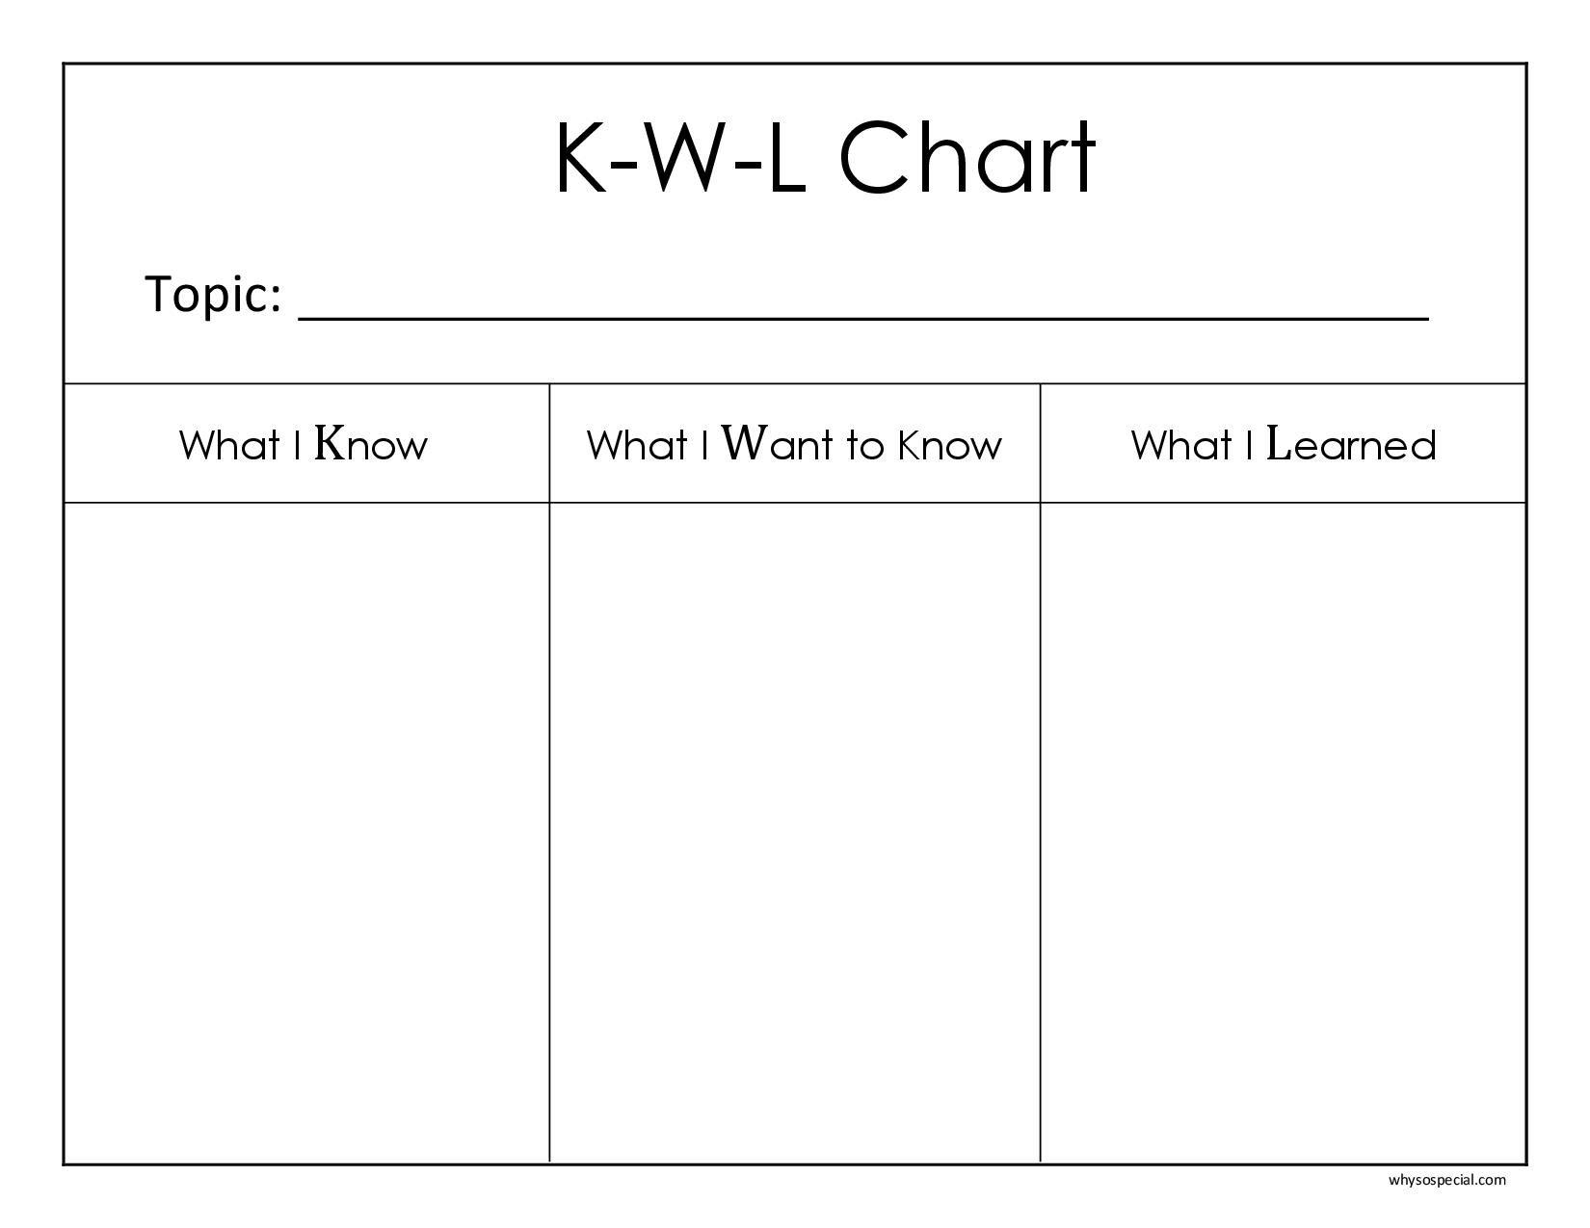
Translanguaging example of practice #1
KWL Charts
Notes:
KWL charts
KWL charts are graphic organisers that can be used to track what students ‘know’, ‘want to know’ and have ‘learned’ during class. They can be used with any topic by learners in any year level. The KWL is designed to engage students throughout their learning. The ‘know’ section helps students to activate their schema on the topic and make explicit what they already know. The ‘want to know’ section helps students generate questions to guide their learning and make sense of new thoughts. Students add to their KWL chart throughout a unit, eventually completing the ‘learned’ section to demonstrate their progress and as a reflection on their learning of the topic content and their skill development. Individual knowledge over time can be tracked by students using a different coloured pen each time they add to the chart and contributions could be dated. Students can respond in L1, L2, or a combination of both. The use of L1 and L2 has an important cognitive function for students helping them make connections between their prior knowledge in L1 with new in-class learning in L2. Although the teacher may not be able to understand what the student has written in L1, they will know that the student has a certain number of points of information that they may otherwise have not have known if the chart was only in English. When students do these individually, the KWL chart can be used as assessment of students’ prior knowledge at the commencement of a topic, for ongoing formative assessment of learning throughout the topic informing teaching practice, and as a summative assessment at the end of a topic. The chart is also important for learners own self-assessment of their learning.

Slide 10

Translanguaging example of practice #2
Research project reports
Notes:
Research project reports
A commonly used open-ended task, is research project reports. These can be about any topic and can be teacher- or student-driven. Once a topic is selected, and perhaps key questions to investigate are decided upon, students search for information and read. Immediately this invites a multitude of opportunities for students to use their full range of linguistic resources across languages. It can include searching for and locating internet sources of information in any language and the reading of them, reading L1, L2 or bilingual texts, using dictionaries in any language including bilingual dictionaries and picture dictionaries, and speaking with and communicating (via such things as emails, letters, text messages, phone interviews) with resource people (anywhere in the world). Each of these, build content knowledge on the topic. Allowing research to be done in any language enables a greater depth and detail in the project because students are able to use their linguistic strengths. Graphic organisers (such as Venn diagrams, mindmaps, T-charts, see Teach Starter, 2021) can then be used to support the writing process. Graphic organisers provide a structure for writing, support students to plan their work, and provide a way for students to get down their knowledge, thoughts, ideas and questions. These can be used with any language and are important to support the thinking and planning process for learners’ writing. It is not important for teachers to be able to read students work for it to be valuable for students, for it to enhance their learning and increase their confidence in their learning. Observations and student conferencing can be used as formative assessment, leading to teachers providing targeted support. Scaffolding is one form of targeted support during the project writing process including such things as guided writing, joint construction, modelled writing, shared writing and teacher- or peer-editing. Multilingual resources such as bilingual texts, dictionaries and L1-speakers are valuable forms of support at this stage too. The final product is a written research project report. The final stage may also include project presentations. Multilingual learners’ languages could be drawn on in oral presentations by using a language of choice with an audience of choice. For example, students may choose to present their project to peers or another class in L2 English or may choose to present in L1 to their family, a community group, or L1-speaking friends.

Slide 11
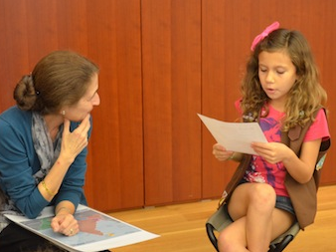

Translanguaging example of practice #3
Multilingual interviews and surveys
Notes:
Multilingual interviews and surveys
Multilingual interviews and surveys can be carried out with learners of all year levels for a variety of purposes, within a variety of topics. One task that involves multilingual interviews is interviewing family members from different generations to find out about daily life for them at the students’ current age. Learners design a set of questions to ask them, ask the questions orally (L1, L2, mix of L1 & L2, possibly even L3, L4+) and record the responses (in any language/s). Students then summarise what they found out (in any language) and create a way to show what they learned (oral, written, multimodal, using L1, L2, or both). Students then share what they learned with a classmate (L1 or L2) which may involve two-way (or more) translation, then with a group, then with the teacher and whole class (L2 English). This process moves from a small supportive one-to-one sharing, increasingly building the size of the group that is being communicated with. The familiarity and repetition of presenting to new audiences supports students’ confidence with larger group presentations. Finally, students write letters of thanks to the family members that were interviewed in the language used with them if possible. This task is a powerful way to use multilingual learners’ repertoires to gather information, demonstrates value in gaining knowledge using languages and engages families in class work.
Similarly, multilingual surveys can be conducted which authentically utilise the language repertoires of students. One example of a topic that could be explored beyond the classroom is ‘favourite food’. Students can survey their family and friends for their responses. The surveys may be done face-to-face, on paper, over the phone, via text, email, or other social media (with parental consent), and these surveys can be conducted in a range of languages depending on who students survey. Multilingual use can be particularly encouraged by having a class challenge to gather responses from as many countries as possible and using as many languages as possible. The information can then be collated and graphed, individually, and then again with whole class data. Connections can be made with the mathematics skills of presenting data and interpreting data. There are a multitude of possibilities for assessment. In this example, students’ understanding of mathematical concepts and their ability to present and interpret data could be a focus for assessment. In this case, these understandings can be visually demonstrated regardless of the languages used in the gathering of the data.

Slide 12
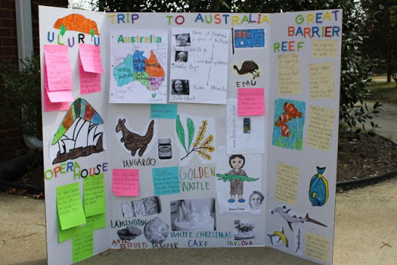
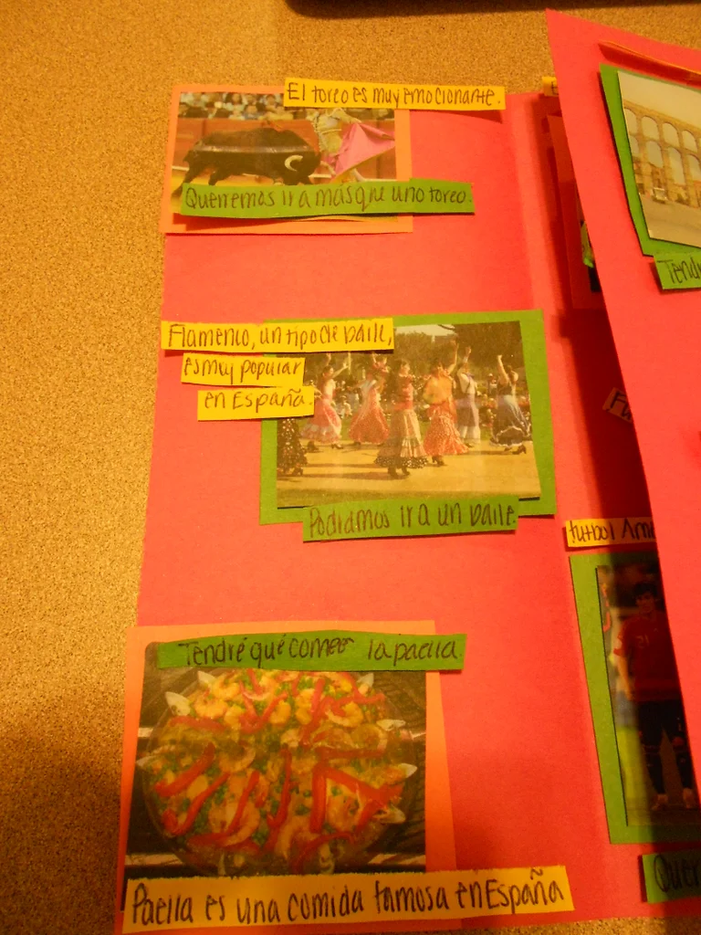
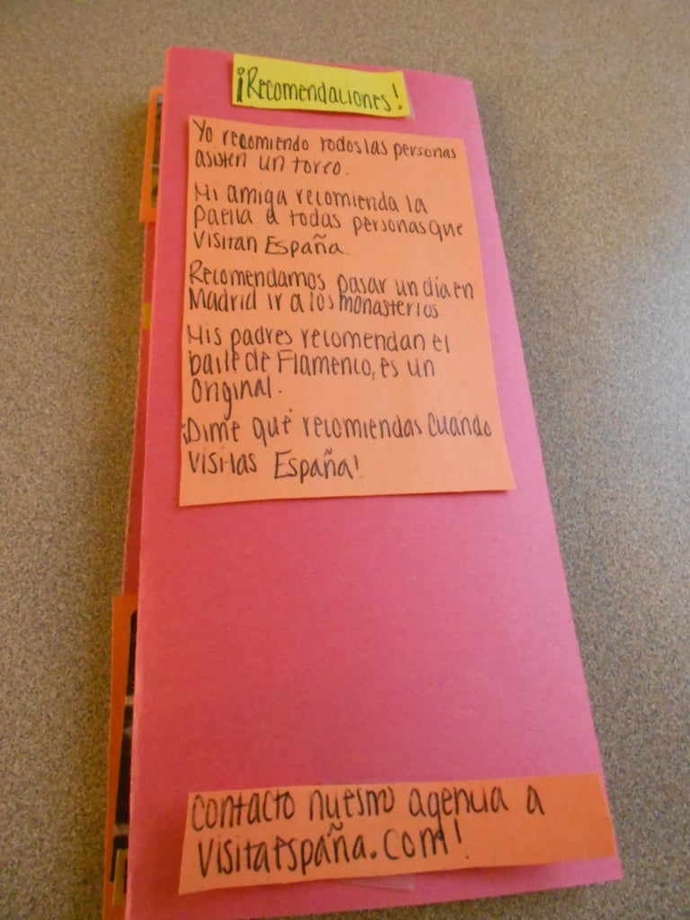

Translanguaging example of practice #4
Multilingual promotional travel materials
Notes:
Multilingual promotional travel materials
This task was designed for a composite Year 5/6 class that comprises a wide range of languages, and they have been learning about places in Australia. They have been tasked to create a promotional travel brochure or video for international visitors coming to their location of choice in Australia. The context is set that the promotional materials are needed in as many languages as possible to provide information to the international travellers. The materials will include information about the travel location and what the visitors can see and do there. The research to gather the information can be done in L1, L2, or a combination of both. It may include such things as books, online resources and resource people. Students’ use of their languages when doing research enables a greater depth of content understanding than if the task is restricted to only English. It also helps them to make connections between their knowledge in L1 and L2. The task includes various elements of choice. Students can create a promotional travel brochure or video, select their travel location, and have choice in which language it will be presented in. The options to create a brochure or video provide opportunities for students to be creative whilst selecting their preferred mode of communication. The brochure will rely more on writing ability, whilst the video will rely more on oral ability, and both utilise images. Formative assessment can be carried out during the task, observing and questioning students about the information they are gathering and what they have found out. The use of images and English text or oral description can support teachers to understand promotional materials that are in languages other than English. This knowledge may support teachers to scaffold the task and guide students’ work. As a culmination, the brochures and videos can be shared with learners’ families and friends as an authentic audience.

Slide 13
“Translanguaging offers a practical way to bring languages that are often invisible at school into classrooms.”
(Wilks-Smith, 2021)
naomi.wilks-smith@rmit.edu.au
Notes:
To wrap up, translanguaging is proposed as a practical way to challenge traditional monolingual practices in schools and invite the plethora of multilingual students’ languages into classrooms. And importantly, it brings languages that are often invisible into classrooms and demonstrates a valuing of them.
This practice demonstrates linguistic inclusion, acknowledges the capabilities of learners that are across languages, and can be used to leverage classroom learning. In this way, translanguaging contributes towards more equitable teaching and assessment practices for multilingual learners and fosters greater social and educational justice.
Although the need to include multilingual learners’ languages in classroom practice is becoming more widely understood by teachers, actual classroom practice enacting linguistically-inclusive pedagogy is less developed and it is hoped that by sharing translanguaging practices it can contribute towards more widespread use in schools.

Slide 14
Further reading & references
Faulstich, O. (2015). Immigrant children in transcultural spaces: Language, learning, and love. https://ebookcentral.proquest.com
Garcia, O. (2009). Bilingual education in the 21st century: A global perspective. Oxford, United Kingdom: Wiley-Blackwell. https://ebookcentral.proquest.com
Garcia, O., Johnson, S., & Seltzer, K. (2017). The Translanguaging Classroom: Leveraging Student Bilingualism for Learning. 1st Edition. ISBN: 978-1-934000-19-9.
García, O., & Kleyn, T. (Eds.). (2016). Translanguaging with multilingual students: Learning from classroom moments. New York, New York: Routledge. https://ebookcentral.proquest.com
Rowe, L. (2018). Say It in Your Language: Supporting Translanguaging in Multilingual Classes. Reading Teacher, 72(1), 31-38. https://ila-onlinelibrary-wiley-com.ezproxy.lib.rmit.edu.au/doi/full/10.1002/trtr.1673
Thomson, P. (2002). Schooling the rustbelt kids. Making the difference in changing times. Sydney: Allen & Unwin.
Thomson, P. & Hall, C. (2008). Opportunities missed and/or thwarted? ‘Funds of knowledge’ meet the English national curriculum, The Curriculum Journal, 19:2, 87-103, DOI: 10.1080/09585170802079488
Wilks-Smith, N. (2017). The Place of Learners’ Languages in Literacy Programs: Bringing learners’ home languages in through the school gate. Babel, 52(1), 27-34.
Wilks-Smith, N. (forthcoming 2021). Translanguaging Pedagogies for Multilingual Learner Assessment. in Barkatsas, T. & McLaughlin, T. Eds. Authentic Assessment and Evaluation Approaches and Practices in a Digital Era: A Kaleidoscope of Perspectives. Brill Sense: The Netherlands.

